Slide 1
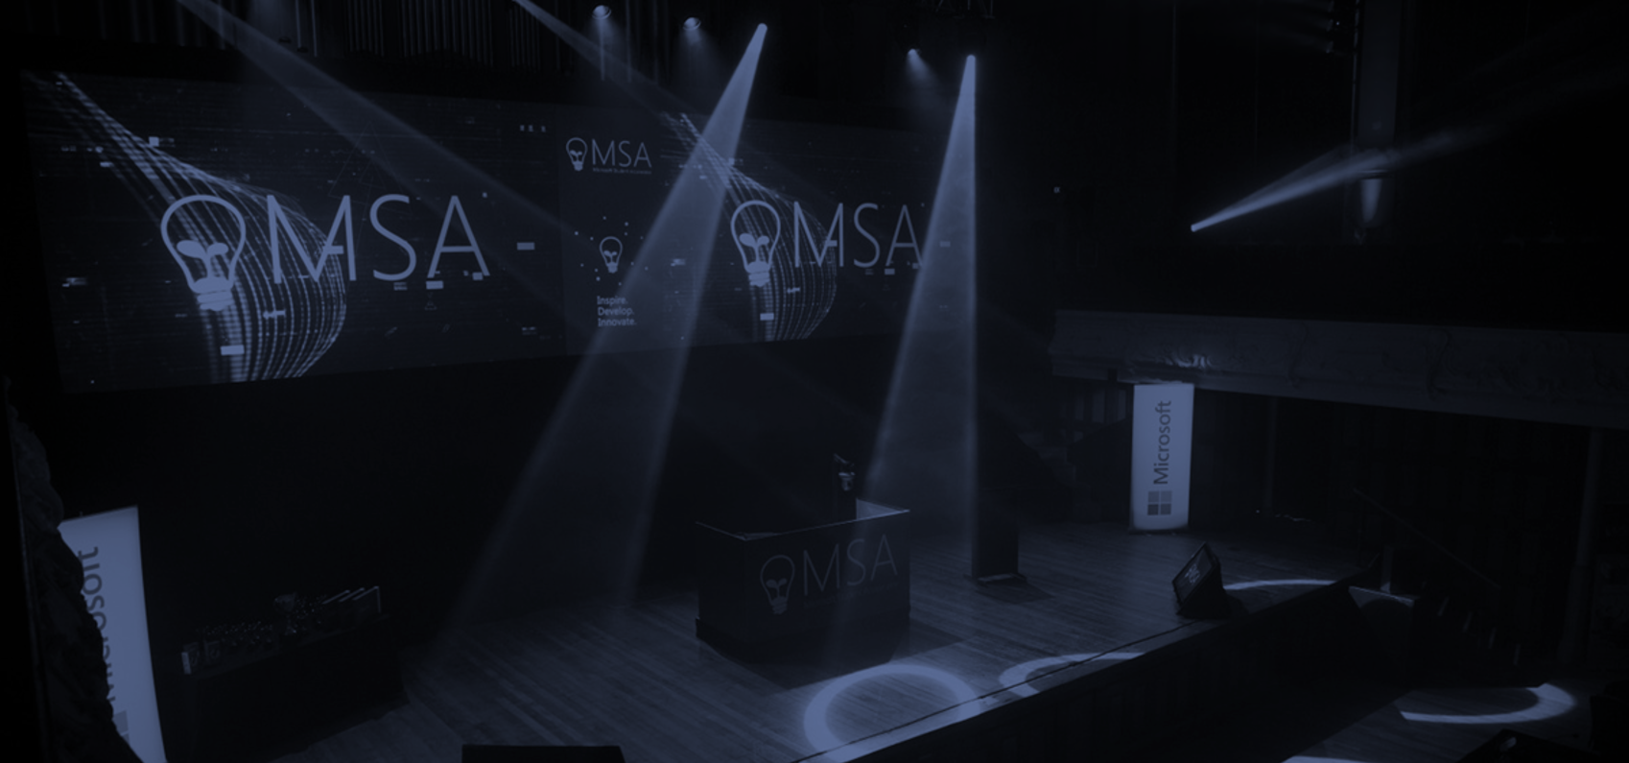

Microsoft Student Accelerator
Inspire. Develop. Innovate.

Slide 2

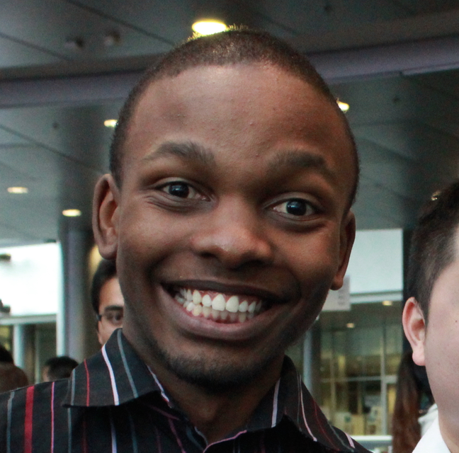

Meet the Team!
Vishesh Oberoi
Technical Evangelist, Microsoft
@ovishesh
Brian Mbuba
Microsoft Student Partner
Jason Goodsell
Microsoft Student Partner

Slide 3
Agenda!
Time | Session
10:30 | Introduction and Overview
10:40 | Construct 2 Showcase
10:55 | Create a Construct 2 Game
11:25 | BREAK
11:30 | Activate DreamSpark and Microsoft Azure
11:55 | Publish game as a Website
12:20 | Recap and Future-looking
12:30 | END

Slide 4
Microsoft Student Accelerator
Inspire. Develop. Innovate.

Slide 5
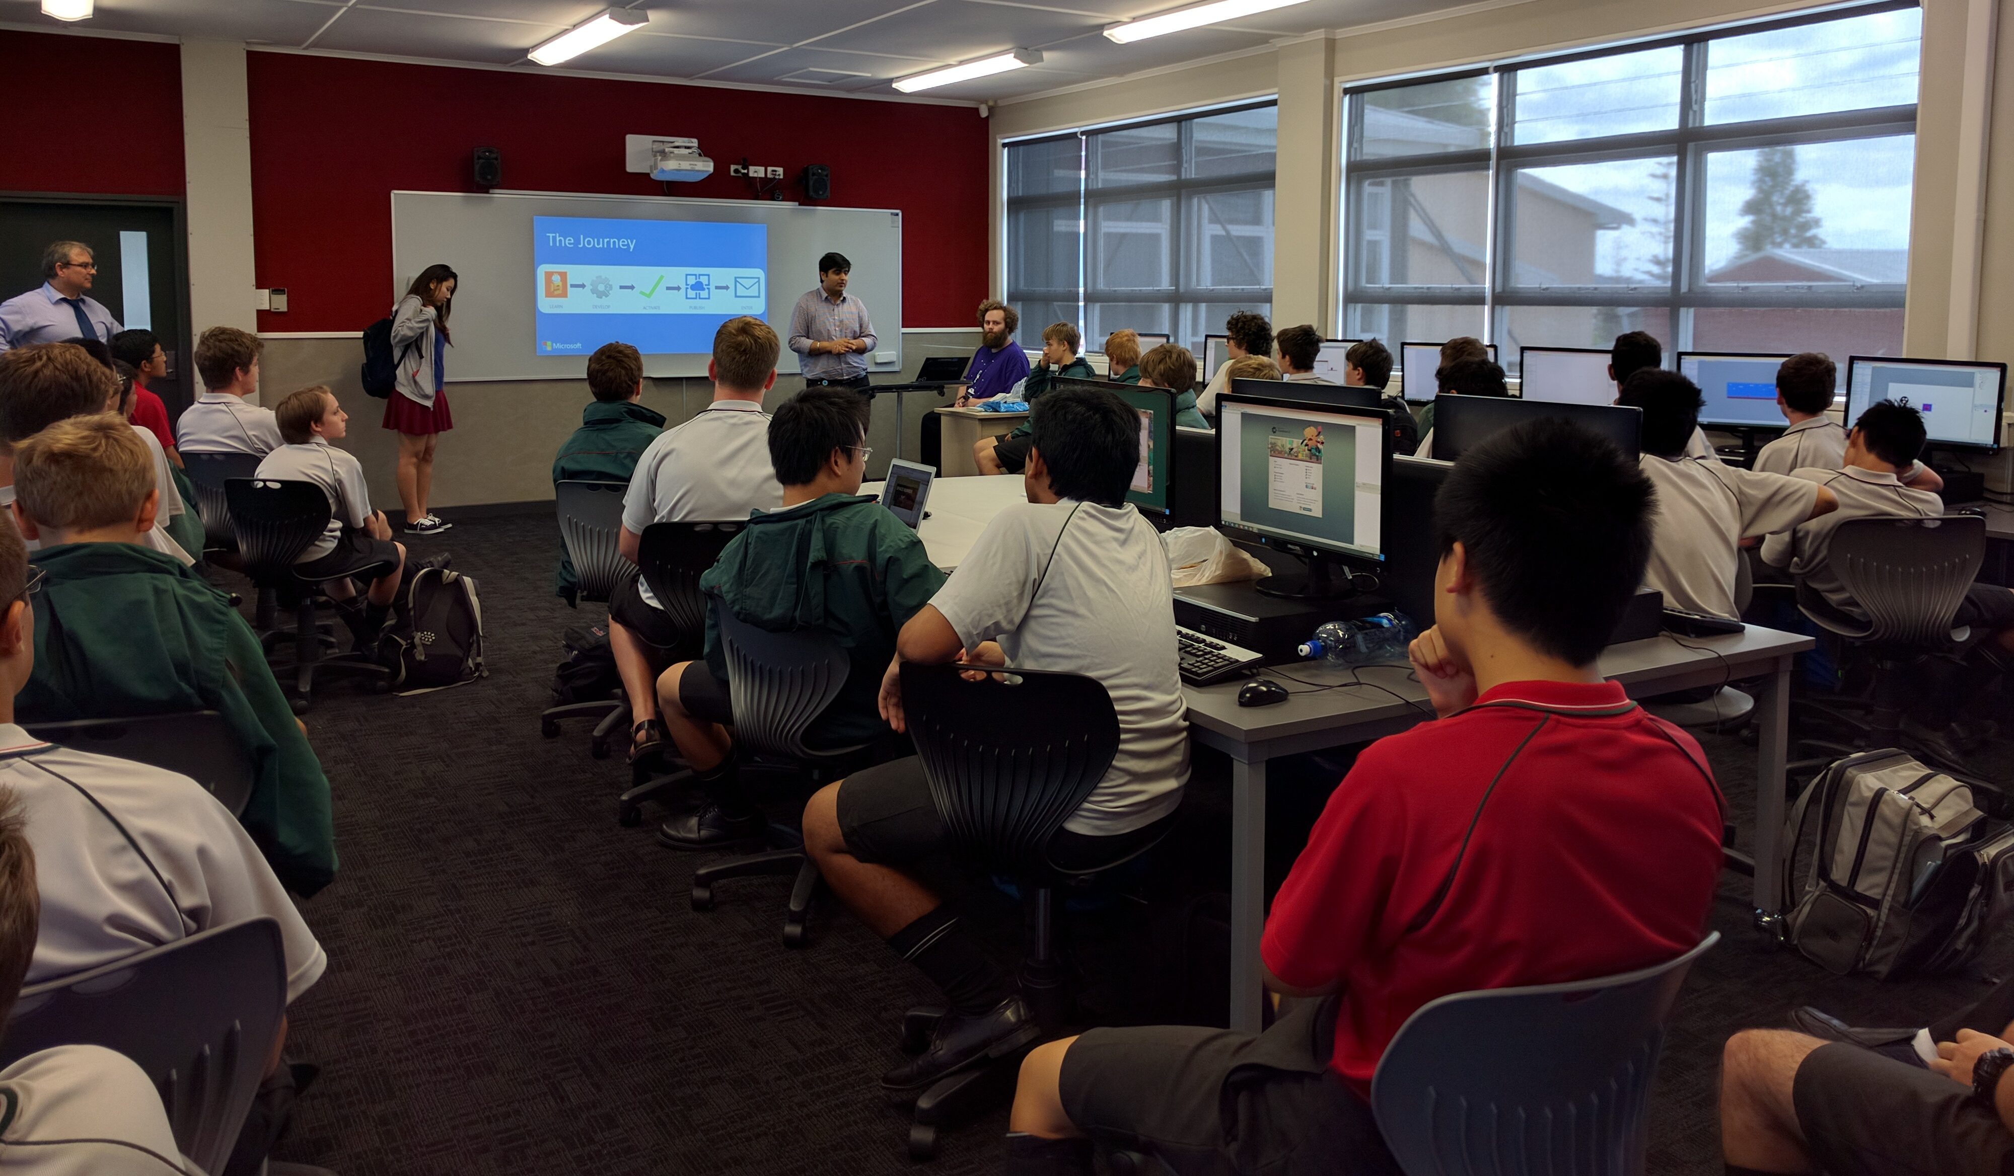
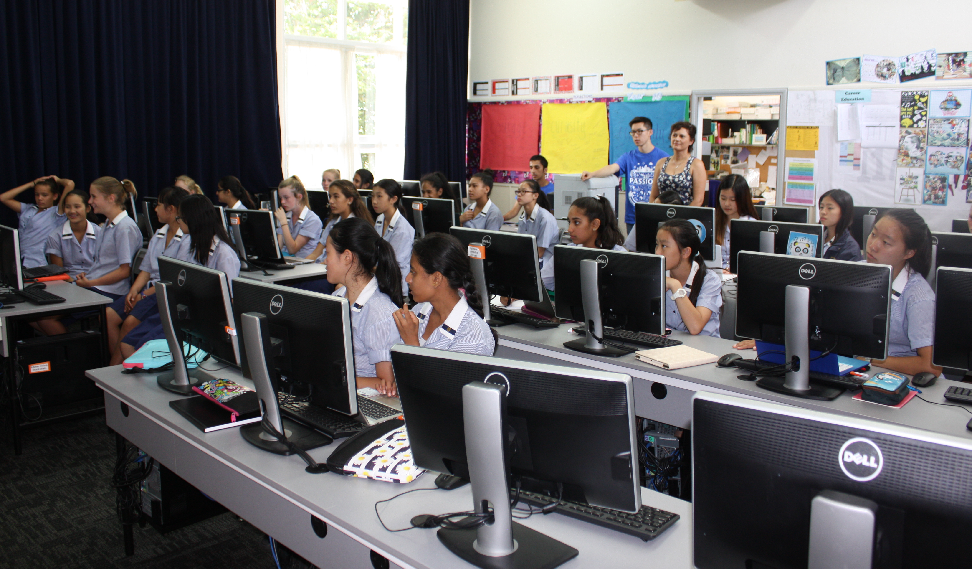
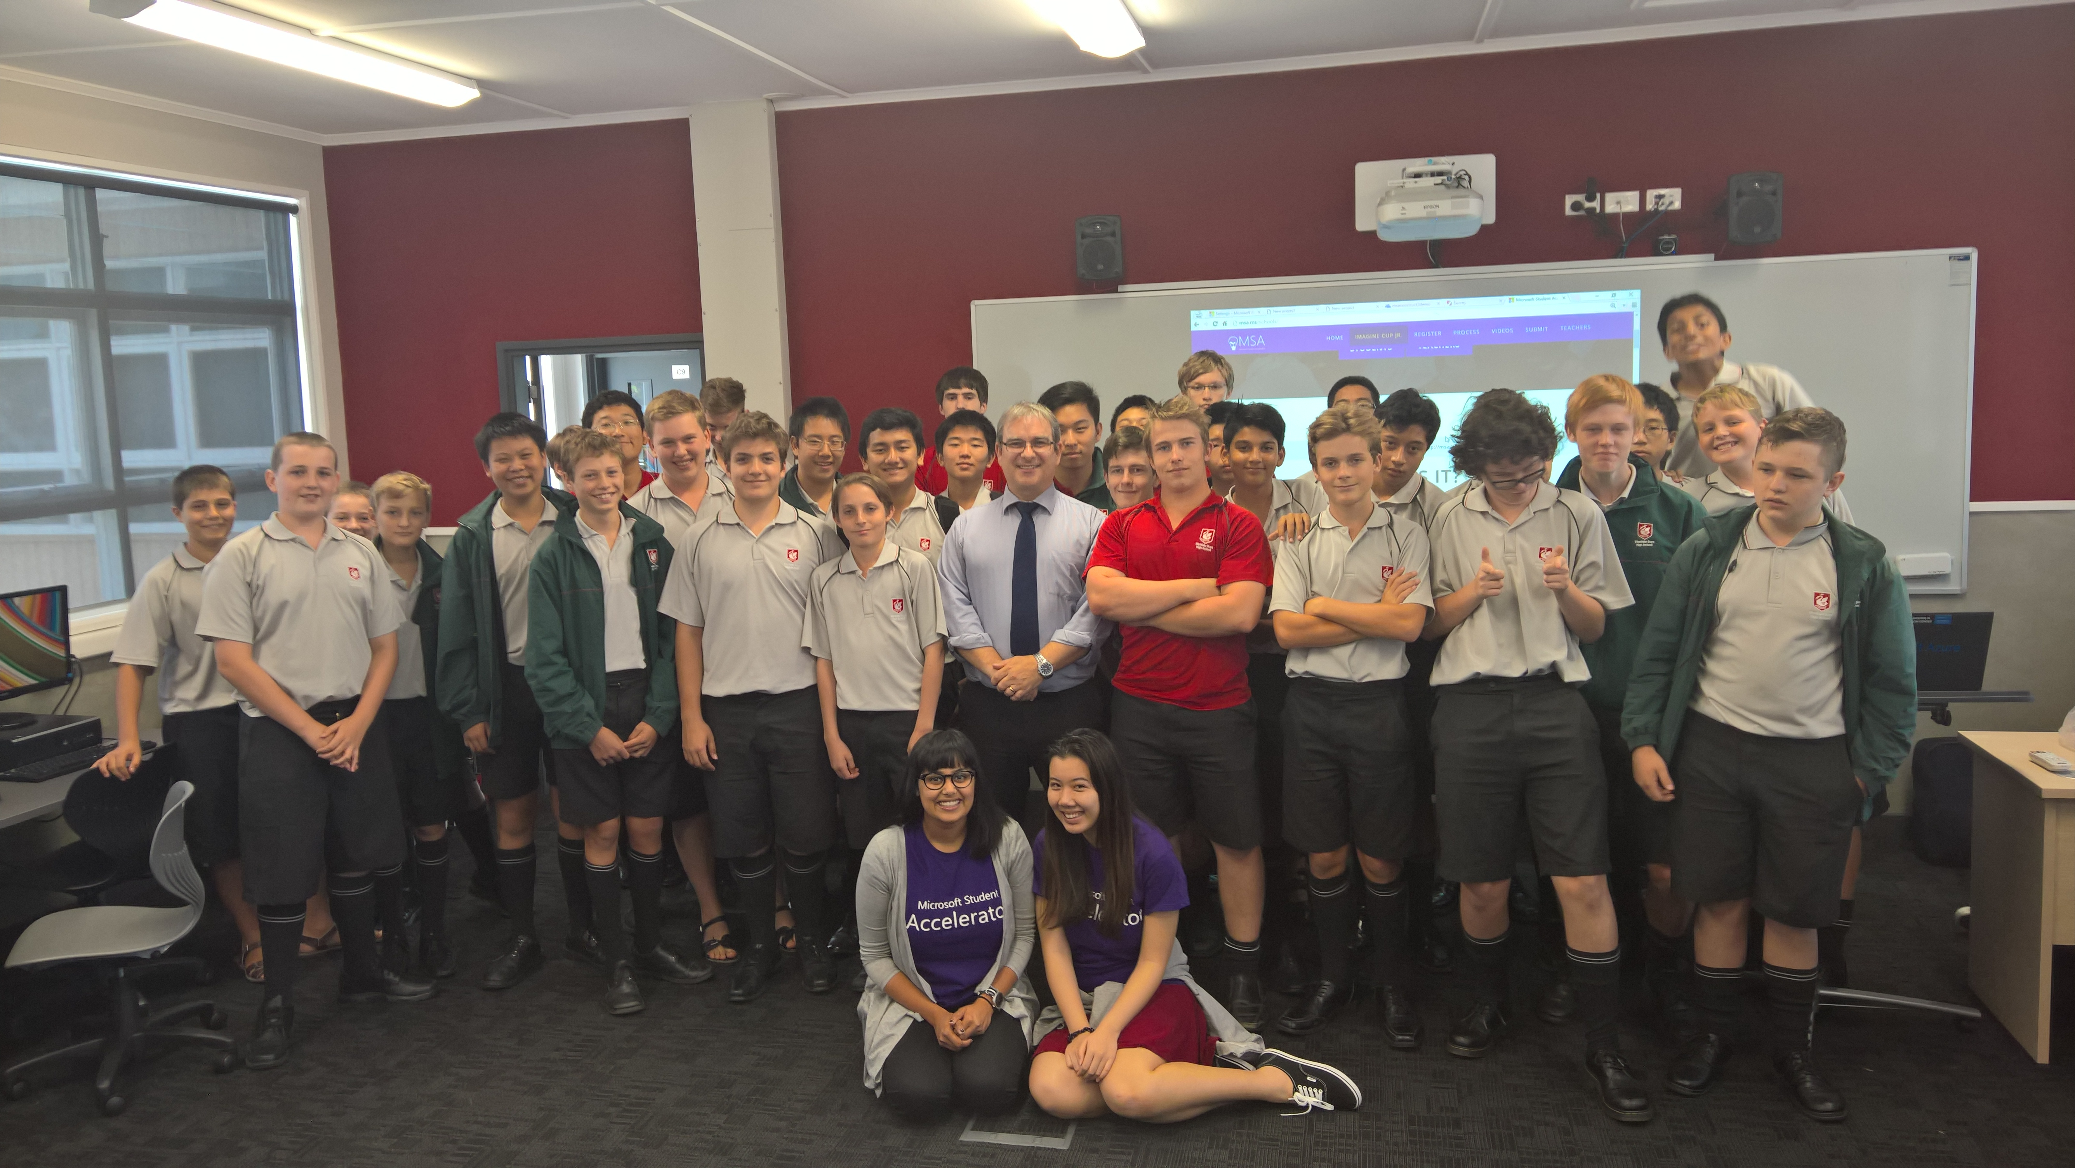
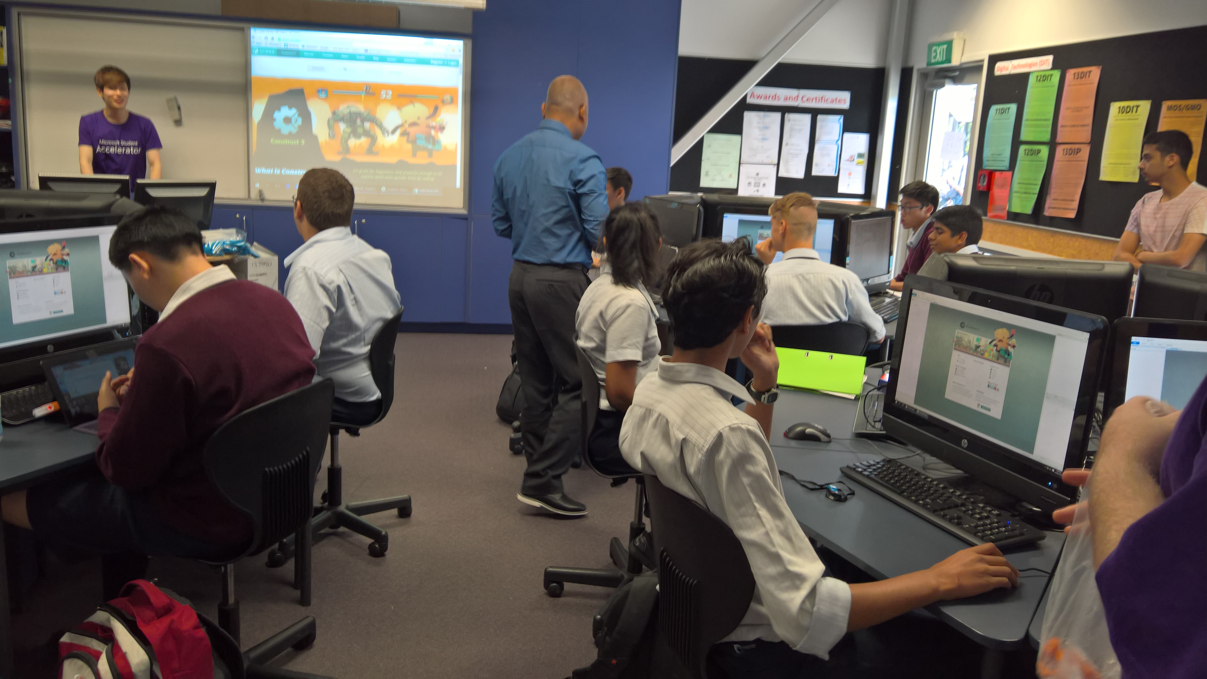
Inspire.
Online Training Series
Teacher Workshops
High School Workshops
Imagine Cup Junior
http://msa.ms/schools

Slide 6
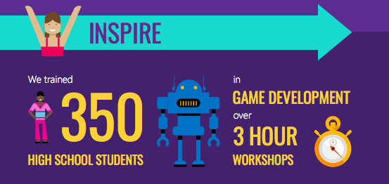

Slide 7
Demo!
Notes:
1 Max Crawford Longbay college Year 11 Auckland http://theadventuresoflumo.azurewebsites.net/
2 Yuewei Zhang Pakuranga College Year 10 Auckland http://contrast.azurewebsites.net
3 Cheng-Zhen Yang Auckland Grammar Form 5 Auckland http://finalpenalty.azurewebsites.net/
http://theadventuresoflumo.azurewebsites.net/
http://contrast.azurewebsites.net
http://finalpenalty.azurewebsites.net/
Publish from Construct 2 to Azure

Slide 8





Process
ATTEND or LEARN
DEVELOP
ACTIVATE
PUBLISH
ENTER
Notes:
[click]
Watch videos on this website, specially created by Microsoft Student Partners.
[click]
Create a game using Construct 2 based on the learnings from the Videos you saw on Channel9.
[click]
Activate Microsoft Azure as perVideo 10.
[click]
Get a special code to activate Microsoft Azure and publish your game as a website. Watch Video 11.
[click]
Submit your entry for the competition by filling in this form.

Slide 9
Requirements
Groups of 2 to 4 students (Only for the JHack Iteration)
Construct 2 Game Published on Azure as a Web App, with:
Start Screen
Game Screen
End Screen
Add one of the below:
Parallax
Scoring
Source Control via GitHub
Facebook Integration

Slide 10
Judging Criteria - JHack
100%
Concept (25%)
Fun (40%)
Execution (20%)
Requirements (15%)
Only Construct 2 Games are allowed

Slide 11
Submission
Submit through http://msa.ms/jhacksubmit

Slide 12
Construct 2

Slide 13
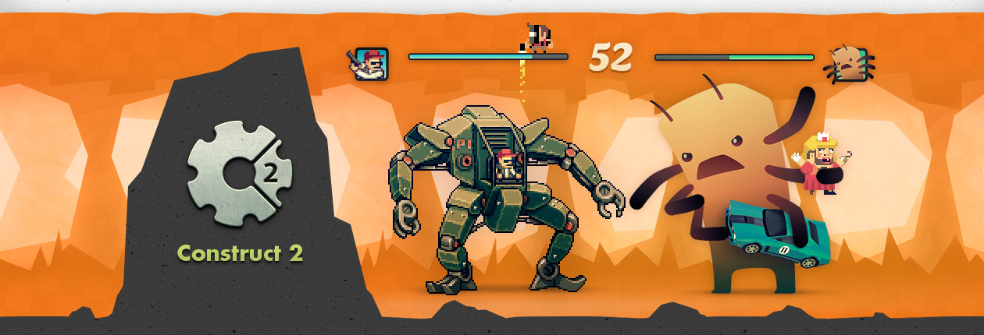
What is Construct 2?
Construct 2 is a powerful HTML5 game creator for 2D games.
Notes:
HTML5 – runs in your browser, see this later
Can make really cool games under an hour

Slide 14

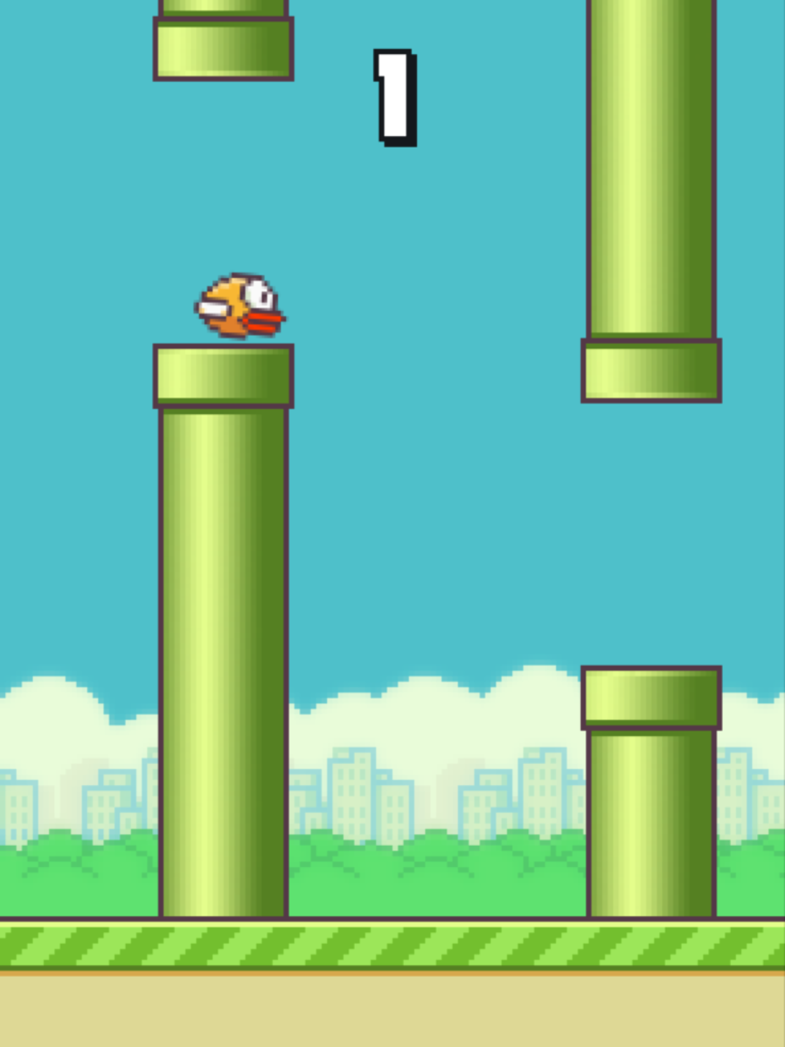

Why Construct 2?
Free
Fun, powerful + easy to learn (even for non-programmers!)
Doodlejump, Flappy bird, Jetpack Joyride, Candy Crush, etc.
Game can be published as a website/app
Notes:
Very accessible to students, Who doesn’t like free stuff
v. Beginner friendly
Even if you’ve never coded before, construct 2 will give great exposure to the logic behind making a game, so that you can then go on and make more complex games
Fun and engaging way to learn programming principles
Share w/others, make $

Slide 15




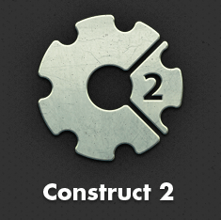


Publish Anywhere…
Notes:
Construct 2 publishing
HTML5 website -> web server
Scirra Arcade
WP8 or Windows 8
PhoneGap -> iOS or Android

Slide 16




Notes:
So we have learnt construct 2 now, how many of you know about C#? Get answers from students - explain to them basically what C# is.
Could even tell them about visual studio or xamarin
Cross platform apps
Universal apps on windows store

Slide 17
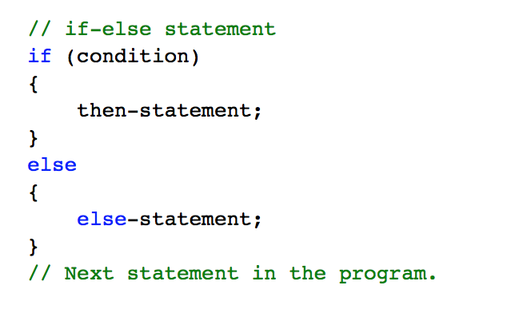
If-else statement in C#
Notes:
Tell the students who are new to this that it’s not scary give them an analogy, tell them think of this like English. Give them an example for instance if you walk in the rain you get wet else you don’t get wet. This is a fundamental statement in programming and it is used in most programming languages
For those that have programmed tell them that it is very similar as you can see to other programming languages
In an if-else statement, if condition evaluates to true, the then-statement runs. If condition is false, the else-statement runs. Because condition can’t be simultaneously true and false, the then-statement and the else-statement of an if-else statement can never both run. After the then-statement or the else-statement runs, control is transferred to the next statement after the if statement.

Slide 18
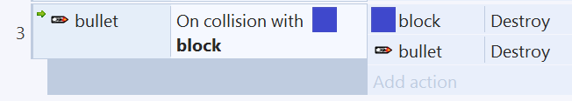

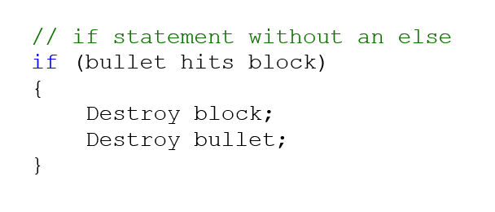

Slide 19
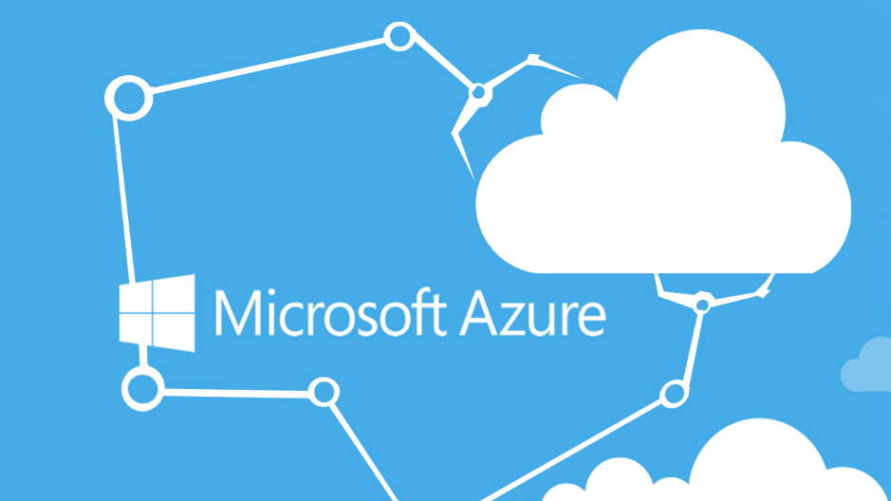
Notes:
This is where you will now move over to a browser and walk them through the steps on how to publish
Remember google chrome will create sub folders for you
Use Drop box if one drive throws an error.
This will then lead on to the help session where students can ask you help for there own game if you have time

Slide 20
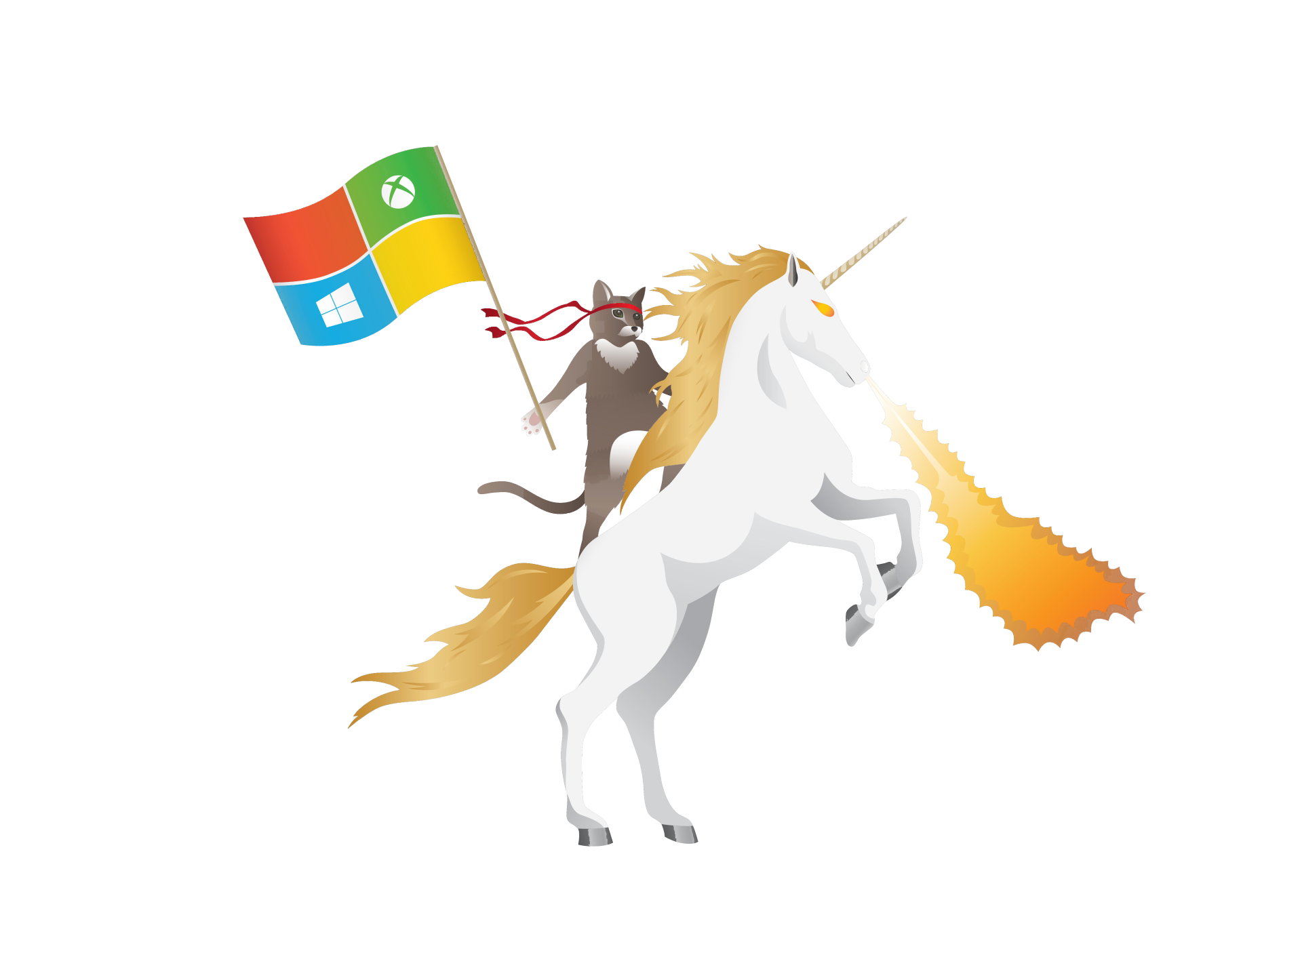
What will students be making?
ninjarunnergame.azurewebsites.net

Slide 21
Next Steps
Visit http://github.com/ovishesh
Visit http://msa.ms/ and Register now!
Watch all the videos (Homework)
Activate Microsoft Azure (Homework)

Slide 22
Thank you!

